Slide 1

Stigmergy: emergent cooperation
www.davidhales.com

Slide 2
21st Century Science
Focus on interactions and systems as a whole
Holism versus reductionism
Emergent properties and self-organisation
Lack of central control
Study of biological and social systems
Dissolution of disciplinary boundaries
Often called: Complexity Science

Slide 3
Complex Adaptive Systems
CAS involve complex interactions of subunits
System behavour emerges “bottom-up” without central plans
Patterns and order emerge via a process called “self-organisation”
Similar self-organising processes can be found in diverse CAS
Complexity Science tries to understand these processes

Slide 4
Stigmergy
“Stigmergy is a mechanism of indirect coordination between agents or actions. The principle is that the trace left in the environment by an action stimulates the performance of a next action, by the same or a different agent. In that way, subsequent actions tend to reinforce and build on each other, leading to the spontaneous emergence of coherent, apparently systematic activity.”
Wikipedia

Slide 5
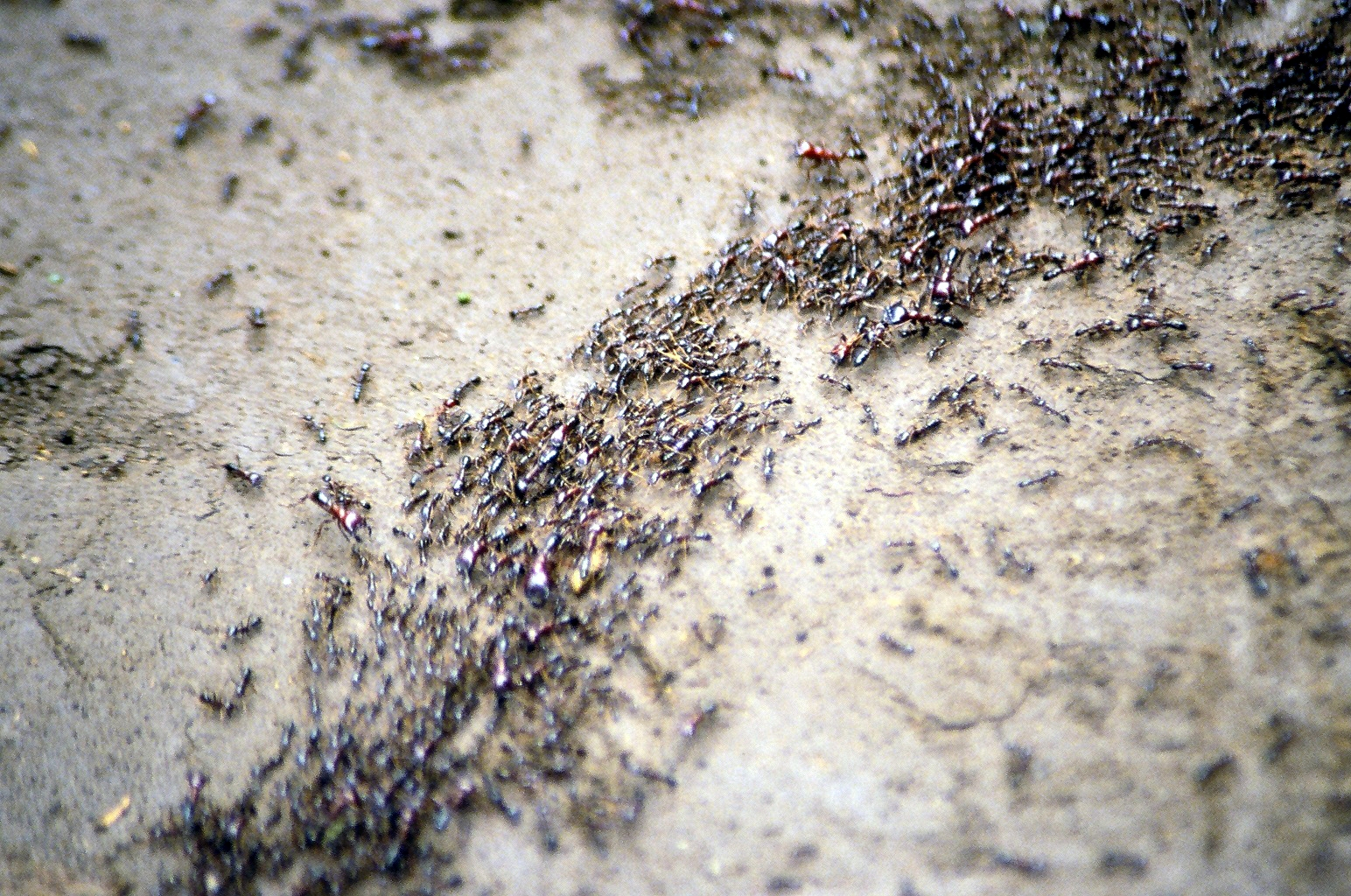
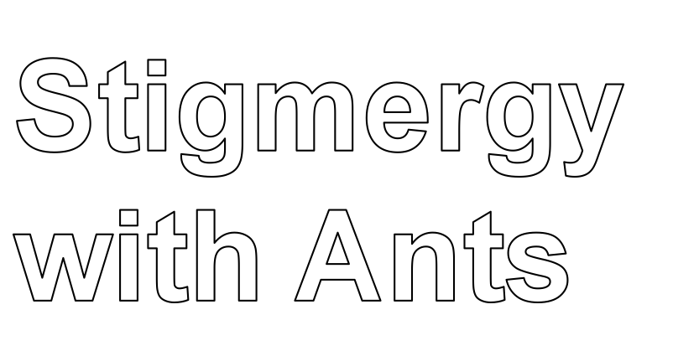

Slide 6
Stigmergic ant foraging
Consider a colony of ants
They need to find resources and bring them back to the nest
New resources may appear and old ones may disappear
Individual ants may disappear (die)
How to organise efficient logistics under these difficult conditions without central planning?

Slide 7
Stigmergic foraging
Consider each ant follows this simple rule:
  Leave nest and wander around randomly
  If you bump into a resource
    Pick it up
    Go back to nest
This isn’t very cleaver because it requires every ant to get lucky and find a resource by accident

Slide 8
Stigmergic foraging
Consider each ant follows this simple rule:
  Leave nest and wander around randomly
  If you detect a pheromone trail then follow it
  If you bump into a resource
    Pick it up
    Deposit a pheromone trail behind you
    Go back to nest
The pheromone trail is a signal left in the environment that other ants can follow
Over time it dissipates away leaving no trace

Slide 9
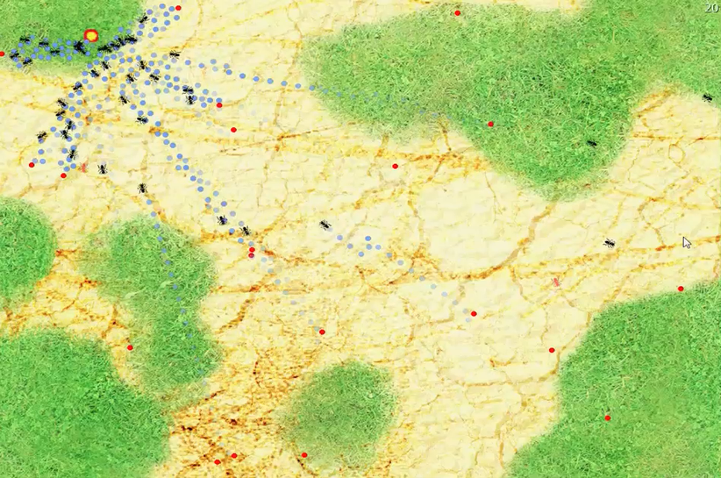
Stigmergic ant foraging

Slide 10

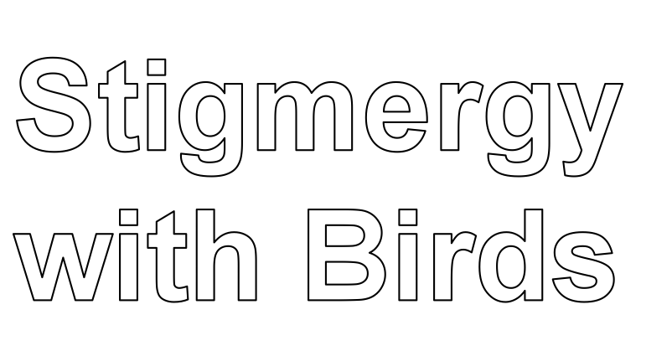

Slide 11
Stigmergy in flocking birds
Basic models of flocking behavior are controlled by three simple rules:
  Separation - avoid crowding neighbors (short range repulsion)
  Alignment - steer towards average heading of neighbors
  Cohesion - steer towards average position of neighbors (long range attraction)
With these three simple rules, the flock moves in an extremely realistic way
Again no central plan or control, communication via the environment

Slide 12
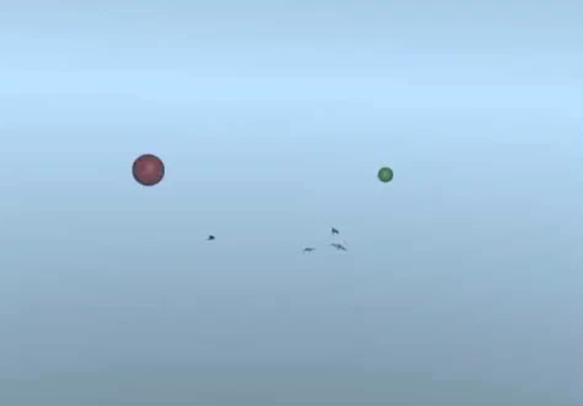
Stigmergic bird flocking

Slide 13
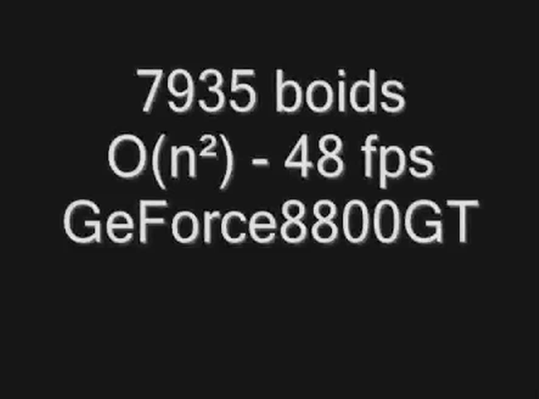
Stigmergic bird flocking

Slide 14
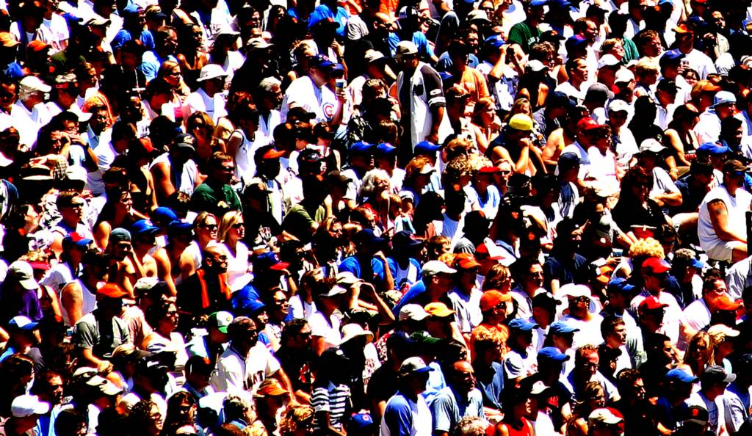


Slide 15
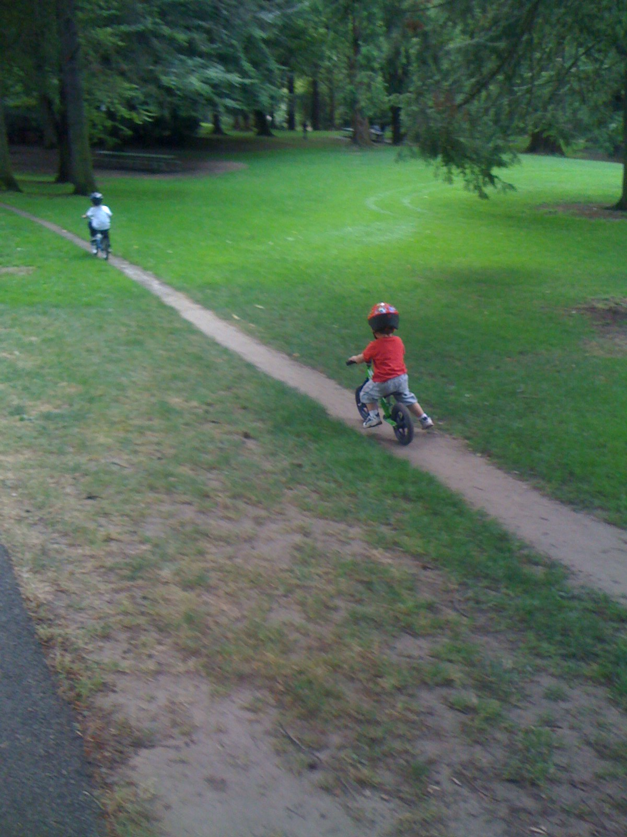
So called “opportunity paths” are very similar to the pheromone trail phenomena in ants

Slide 16

Stigmergic path following in humans

Slide 17
Markets
It has been argued that markets are complex strigmergic systems
No central control (in theory)
Bid / Offer Price = environmental signal
Order emerges from repeated transactions
Efficient under assumptions of rational behaviour (in theory!)
However….

Slide 18
Stigmery in human systems
But people are much smarter than ants!
We don’t just respond to environmental stimuli…
But also we are not rational or smart all the time either…

Slide 19
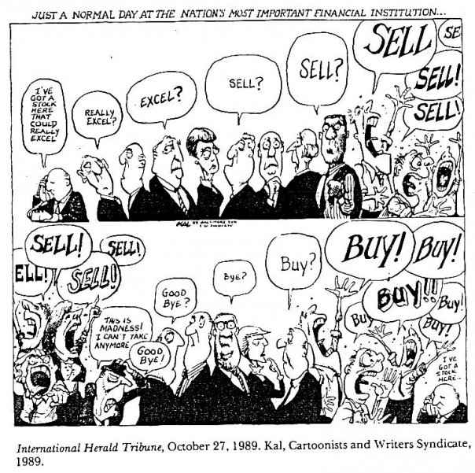
When Stigmergy goes bad!

Slide 20
New Economics
Lots of new work applying Complexity Science to new kinds of “more realistic” economic models
The Economy as a Complex System
More about self-organisation, emergence, and adaptation
Less about rational behavour and efficient markets

Slide 21
Socio-Cognitive Stigmergy
“To know is to cognize, to cognize is to be a culturally bounded, rationality-bounded and environmentally located agent. Knowledge and cognition are thus dual aspects of human sociality. If social epistemology has the formation, acquisition, mediation, transmission and dissemination of knowledge in complex communities of knowers as its subject matter, then its third party character is essentially stigmergic. In its most generic formulation, stigmergy is the phenomenon of indirect communication mediated by modifications of the environment.”
Marsh, L., & Onof, C. Stigmergic epistemology, stigmergic cognition,
Journal of Cognitive Systems Research (2007)

Slide 22
Stigmergy on the internet
Wikipedia:
  No central editor
  The text = environmental signal
  Order emerges from repeated editing
Google:
  No central curators
  Weblinks = environmental signal
  Order emerges from repeated weblinking

Slide 24
Cooperative Systems in General
Individual v. Collective interests
Game theory and “the prisoner’s dilemma”
Axelrod’s tournaments and the tit-for-tat rule
Evolutionary Stigmergic Collectives

Slide 25
Back to Artificial Intelligence
It has been claimed that the mind is not a program but rather a “society” of interacting agents
Minsky’s “Society of Mind”
This might explain why we don’t know how we achieve our intelligent behavior
And also have internal conflicts etc.
The focus is on the interactions between the multiple agencies in our mind

Slide 26
Intelligence is social
A lot of recent focus indicates that to get any kind of intelligent behavour requires a social focus from the start
i.e. the social precedes and produces individual intelligence not the other way around
Machiavellian intelligence etc.

Slide 28
In the “good old days”
Back in the 20th Century, 50’s and 60’s
Technology was going to save us
Computers would become more powerful and intelligent
Cleaver machines would tell us how to solve our problems… Look after us…
“Keep us as pets” – Quote (Fredkin?)
Consider HAL9000 in the movie 2010

Slide 29
The Birth of Artificial Intelligence
Computers expensive, big and few
Heavily funded by military (cold war)
Highly centralised, only a few “boffins” understood them or had access to them
Quote “only need 4 computers…” (who?)
Idea: get the boffins to write big cleaver programs and the computers will become intelligent

Slide 30
But it didn’t work out that way…
Computers are pervasive but quite stupid
Systems are distributed not centralised
Loss of central control
Main use is in communication, coordination and interaction: e-mail, web, social networks
Move away from creating individual super-intelligences – didn’t work anyway
How to create collective or social intelligence?

